Slide 1
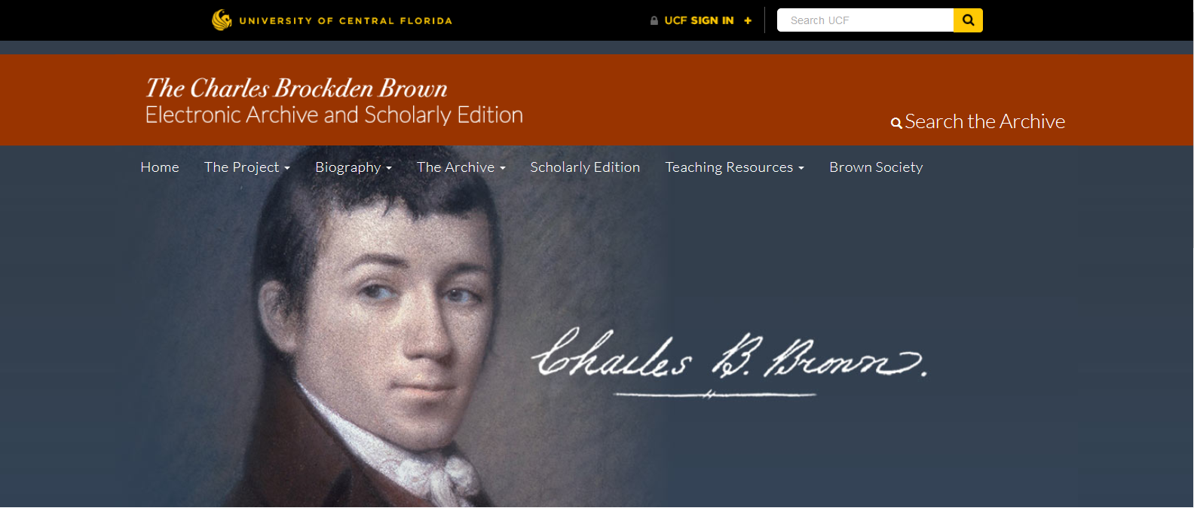


Reimagining the Charles Brockden Brown Archival Site
Amy Giroux and Brook Miller
Center for Humanities and Digital Research
Notes:
My name is Amy Giroux and my colleague Brook Miller and I work in the Center for Humanities and Digital Research here at UCF. You’ll hear our center be called C-H-D-R, or Cheddar.
We have sponsored over 25 Computer Science teams over the years and we have a great track record of successful teams.
The project that we need help with is the Charles Brockden Brown Electronic Archive and Scholarly Edition.

Slide 2
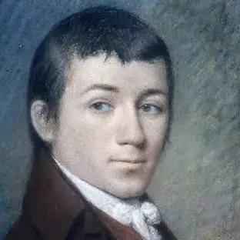
Charles Brockden Brown was an American novelist, historian, and editor of the Early National period. Brown is regarded by some scholars as the most important American novelist before James Fenimore Cooper.
Notes:
Brown was born in 1771 and was only 39 when he died in 1810.
He was a very prolific author and this archive contains both correspondence he wrote and published works.

Slide 3
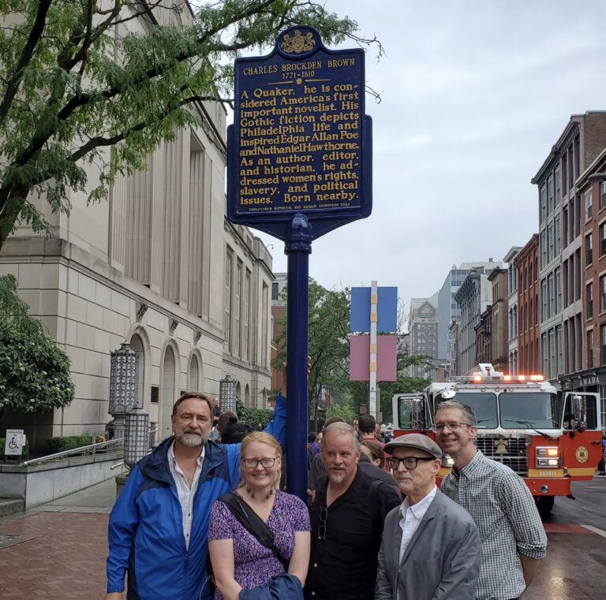
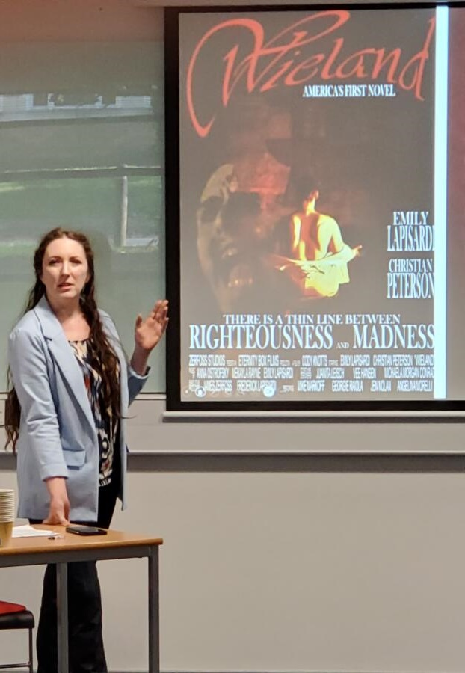
Notes:
There is a very active community of scholars use this archive and website. These scholars have received two grants from the National Endowment for the Humanities to build the original website and to publish 7 scholarly editions of Brown’s works.
Scholars are continually researching and writing about Brown and new publications are added to the archive yearly.
Dr. Mark Kamrath on the left in the blue jacket is a Professor of English here at UCF and he is the Principal Investigator of this project.

Slide 4
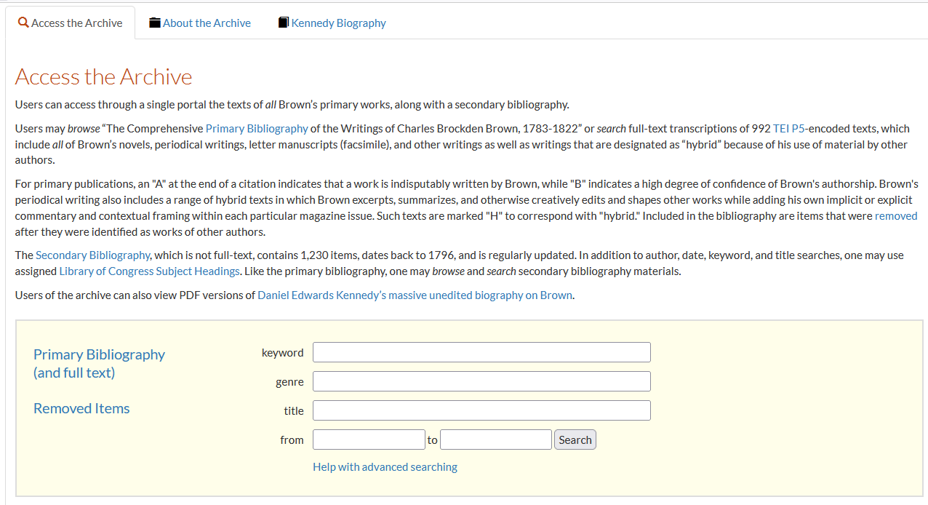
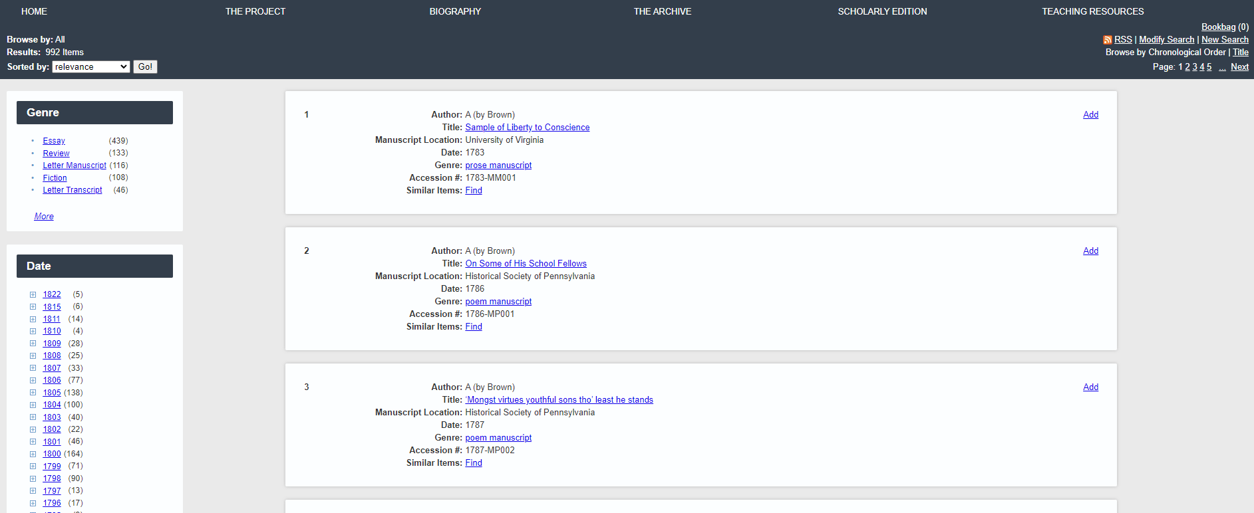
Notes:
The current website was created in the early 2010s and it is feeling its age.
We need you to upgrade the infrastructure that the site is built on and enhance its functionality.
These are the types of tasks that you would be asked to do when you work in industry. Older systems that are still vital to a community, need to get upgraded.

Slide 5
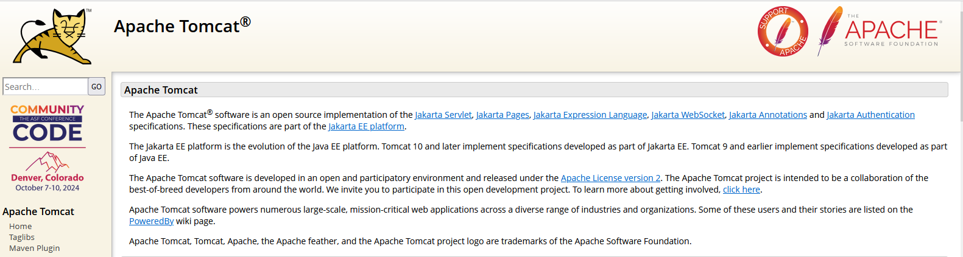
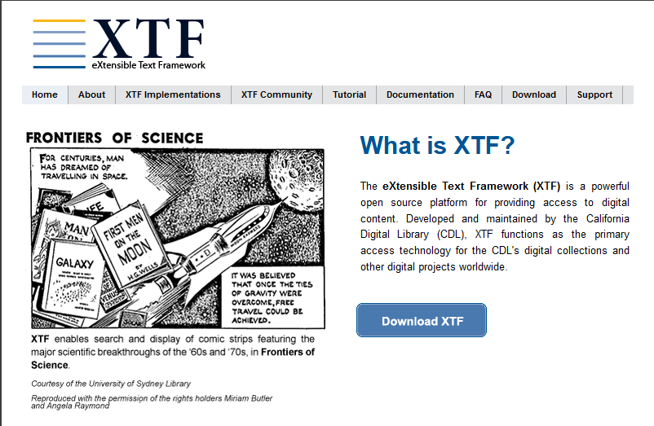
Notes:
The existing backend of the site is based on Tomcat, which is a Jakarta java platform, and XTF which is an extensibe text framework that indexes and serves up XML files.

Slide 6
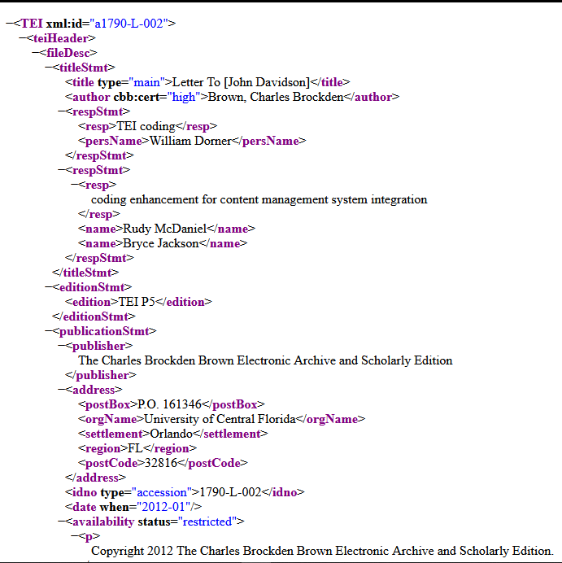
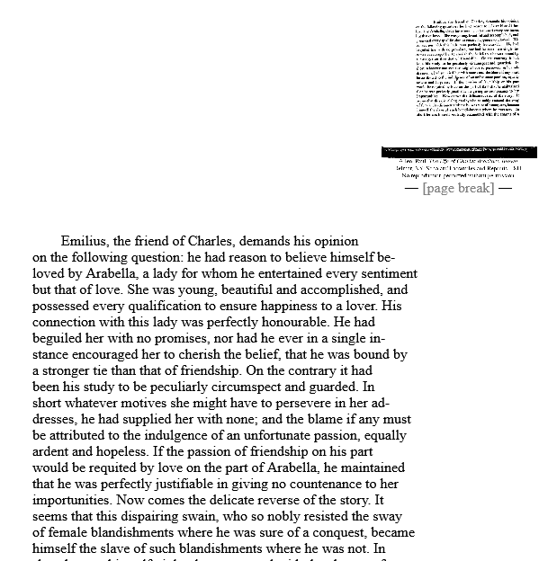
Notes:
All of the database’s documents are encoded in TEI and transformed with XSLT for display.

Slide 7
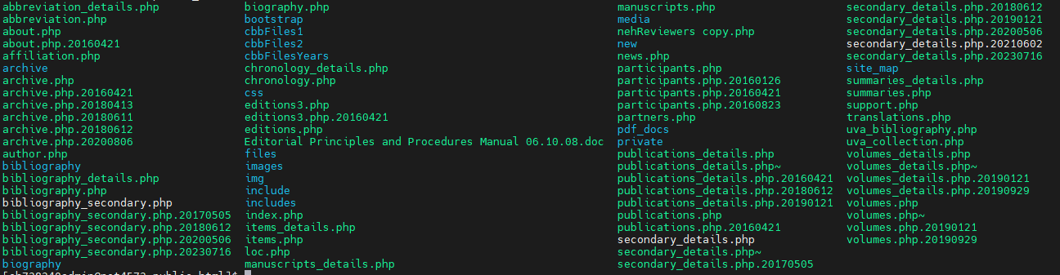
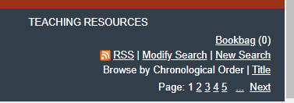
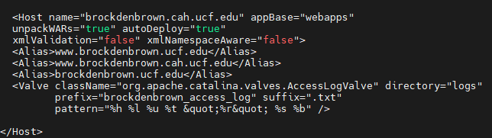
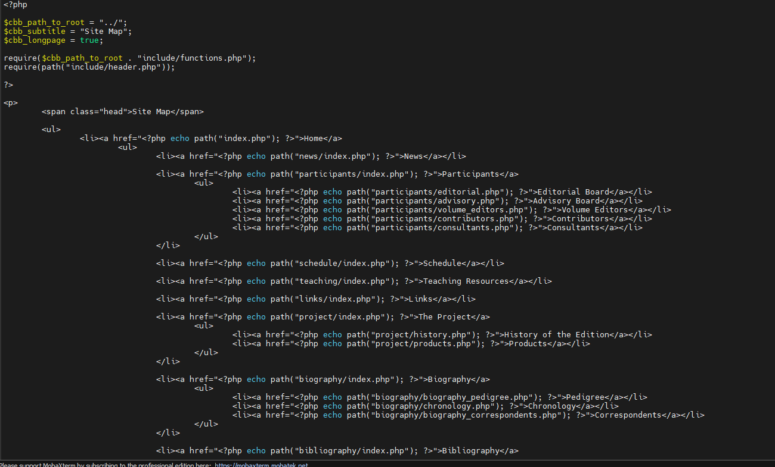
Notes:
You will be building out the new system on our CHDR server and will need to create documentation on the installation of all necessary packages so that we can move the site to the production server once you all are done.

Slide 8




Requirements
Redesign backend for RHEL 9 stack
Migrate all the XML data to exist-db
Redesign UI search/results and make them mobile-friendly
React frontend and an API ajax/php to access the exist-db
Create a zoomable side-by-side display of the document images and the transformed XML for PCs and one for mobile
Create new XSLT transformations for the new viewers
Ensure the Library of Congress Subject Headings search works
Notes:
So, here’s what we need you all to do.
Resdesign the backend to work on a Red Hat Enterprise Linux 9 box.
Migrate the current XML data and files to use Exist-db
Redesign the UI Search and results and make them mobile friendly. This site will work on a phone but it is not really responsive.
The frontend will need to be in React and you’ll need to develop and API to access the exist-db, likely it will be ajax and php
We need a zoomable display of the document and the transformed XML. Right now the images are thumbnails that you can click on to get one larger size. We would like true zoomable.
We also need the viewer to be responsive on mobile.
You’ll need to create new XSLT transformations for the new viewers as they’ll obviously need to work differently than the current implementation.
You’ll also need to ensure that the LOC SH search works. Right now it is controlled by an Excel spreadsheet, but perhaps we can make that easier to maintain also.

Slide 9

Requirements
GDRP cookie warning and Section 508 compliant (alt-text/PDF)
Fix the bookbag functionality (email of list of links)
Migration of data to STARS
  Metadata manifest for all XML files (~1,000)
  PDF file of each document image set
  PDF file of transformed XML for each image set
Full documentation for installation on RHEL 9 as you will be developing on Ubuntu
Notes:
We also need to be compliant in terms of GDRP and section 508.
There is a bookbag function that allows users to select items from the results and email themselves a list. It is currently broken.
The other big piece is to prepare the data for long term storage on STARS. STARS is the universities long term repo. There needs to be a metadata manifest for the XML documents and then PDF files for the images and the transformed XML, plus the XML file itself. The idea here would be for you all to script the formation of these files so that we have the proper bundles to submit to STARS.
And again as I said earlier, we need the documentation to be able to install this on the RHEL production server.

Slide 10
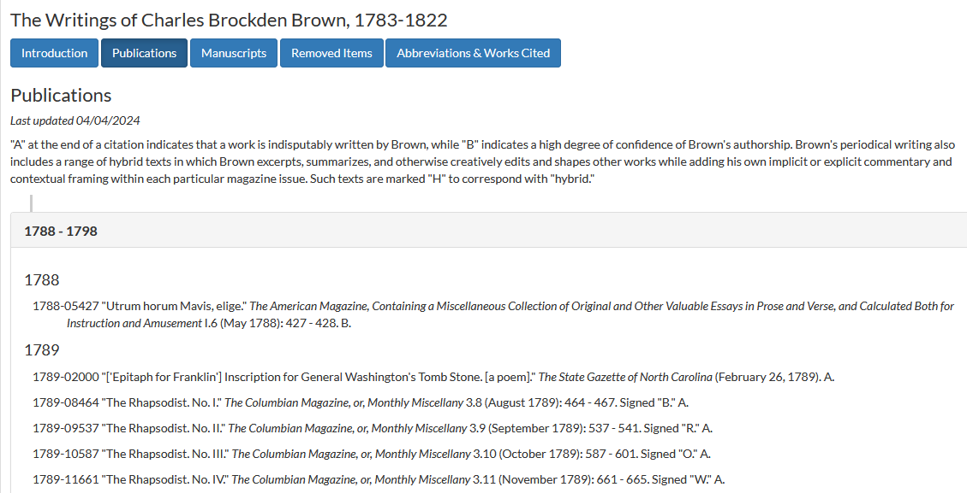
Stretch Goals
Only after the main requirements are completed
  Possibly containerize the implementation using Podman
  Help us rethink how the bibliographies are implemented
Notes:
For stretch goals, we need to have the main requirements complete before you start on these. I’ve had some teams focus on the stretch goals instead of the main goals.
If there is time at the end, we’d like you to look at containerizing the implementation using Podman, which is a Red Hat program.
And the second item would be to help us rethink how the bibliographies are implemented. Right now I have to edit two separate files for these and it may be possible that we could streamline that process.

Slide 11
Contact Info:
Amy.Giroux@ucf.edu
Brook.Miller@ucf.edu
Center for Humanities & Digital Research
Notes:
Here are our emails. Please feel free to reach out with any questions.
We look forward to working with you all.
Thank you.

